Slide 1
Unit 9 Electromagnetism
Part B: Introduction to Electromagnetism

Slide 2
What will you learn?
Relationship between direction of current and magnetic field produced.
Forces between two long parallel current-carrying conductors.
Magnetic properties influencing the flux and flux density.

Slide 3
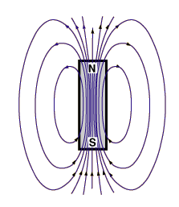
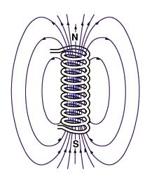
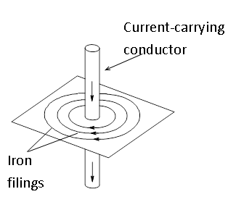
Magnetic Field
A force field exists around a magnet and it is termed the magnetic field.
It is also found around current-carrying conductors and coils.
Field
Field

Slide 4
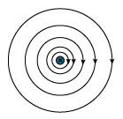

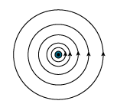
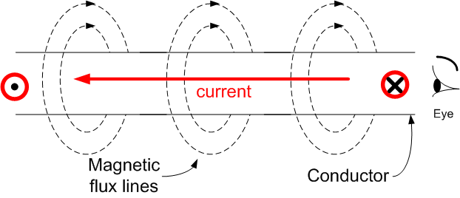

Magnetic Field
Lines of force are in a clockwise direction around a conductor which is carrying current away from the viewer.
Lines of force are in an anticlockwise direction around a conductor which is carrying current towards the viewer.
Current-carrying conductor
Current

Slide 5
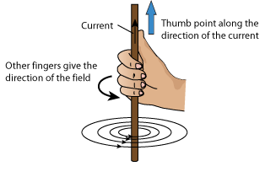
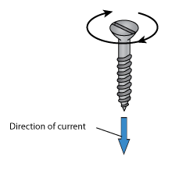
The Right-Hand Grip Rule
The direction of the magnetic field can be identified using the right-hand grip rule:
If the right thumb is pointing to the direction of current flow in the conductor, then all the fingers griping the conductor are indicating the direction of the magnetic field.
Other rule such as the cork screw rule is also useful in determining the magnetic field.
The direction of rotation gives the direction of the magnetic field

Slide 6
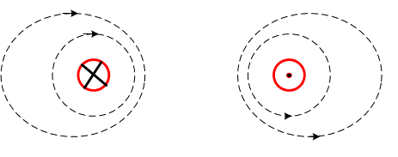
Force of Repulsion
Two parallel conductors with currents flowing in opposite directions.
Magnetic field is additive between the two conductors.
This exerts a force of repulsion between the two conductors.
Repulsive force

Slide 7
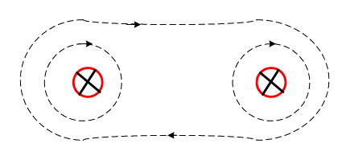
Force of Attraction
Two parallel conductors with currents flowing in same direction.
Magnetic field is subtractive between the two conductors.
This exerts a force of attraction between the two conductors.
Attractive force

Slide 8
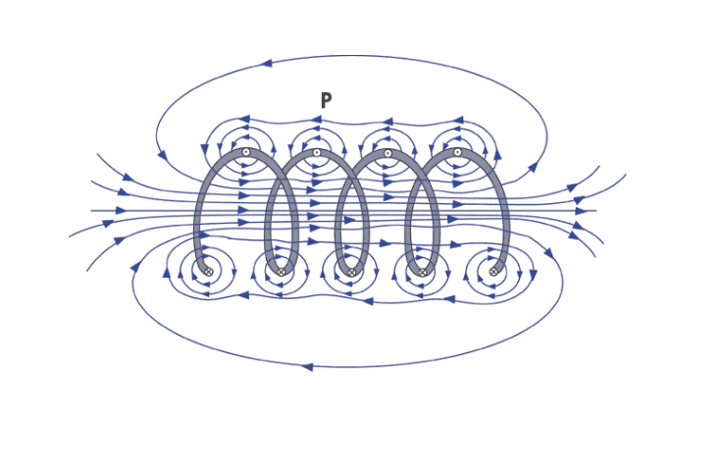

Solenoid
Solenoid refers to a long, thin loop of wire (termed coil), often wrapped around a core, which produces a magnetic field when an electric current is passed through it.
The flux (or field) pattern is similar to a bar magnet.

Slide 9
Magnetic Flux 𝛷 and Flux Density B
Magnetic flux describes (or quantifies) the number of lines of force in a magnetic field.
Its symbol is 𝛷.
Its unit of measurement is weber (Wb).
More commonly used units are milli-Weber (mWb) and micro-Weber (µWb).
Greek capital letter, phi

Slide 10
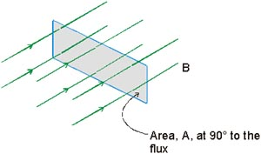
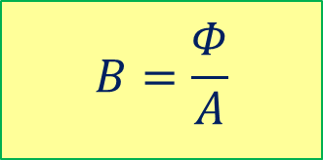
Magnetic Flux 𝛷 and Flux Density B
The magnetic flux density is defined as the amount of flux passing perpendicularly through a unit area in a magnetic field.
Its symbol is B.
Its unit of measurement is tesla (T).
One tesla is defined as the one Weber of flux per square metre (Wb/m²).
Magnetic flux density is given by the expression:
The strength of a magnet is measured by flux density B.
𝛷
$$B=\frac{Φ}{A}$$

Slide 11


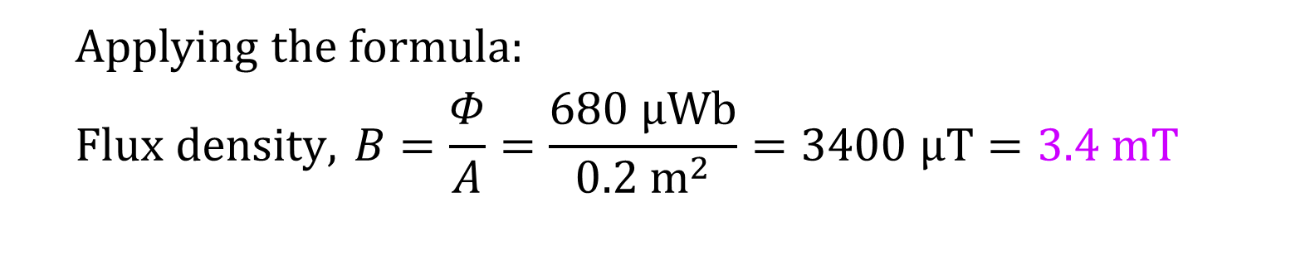
Example 1: A magnetic field has a measured flux of 680 μWb passing through perpendicularly to an effective area of 0.2 m². What is the flux density?
Applying the formula:
$$Flux density, B=\frac{Φ}{A}=\frac{680 µWb}{0.2 m^{2}}=3400 µT=3.4 mT$$

Slide 12
Example 2: If the flux density in a magnetic material is 5.6 T and the cross-sectional area of the magnetic material is 485 × 10⁻⁶ m², what is the flux through the material?
Applying the formula:
Flux, 𝛷 = BA = 5.6 T × (485 × 10⁻⁶ m²) = 2.72 mWb

Slide 13
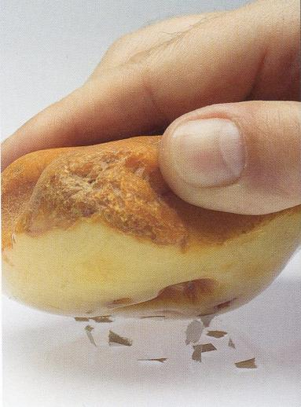
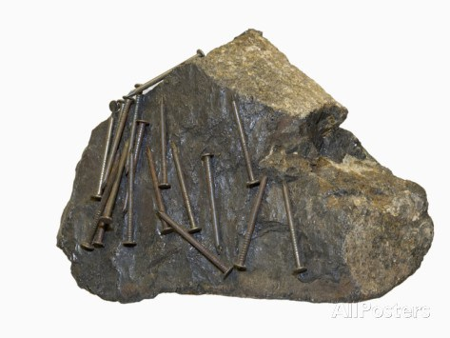
What is “electromagnetism”
The science of electricity took its roots in observation (around 600 BC) that a rubbed piece of amber will attract bits of straw.
The study of magnetism goes back to the observation that lodestones (magnetite) will attract iron.
These two sciences developed separately until 1820…

Slide 14
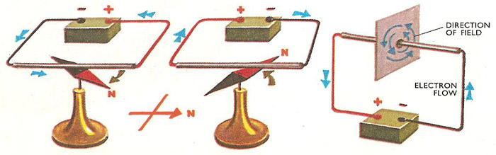
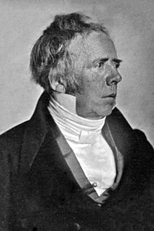
What is “electromagnetism”
In 1820, Hans Christian Oersted observed a connection between them. An electric current in a wire can affect a magnetic compass needle.
The new science of electromagnetism was further developed ever since.

Slide 15
Electromagnetic Properties
The following properties are related to the establishment of an electromagnetic field:
Permeability of the core material, µ
Reluctance of the flux path, ℛ
Magnetomotive force (mmf), F_{m}
These parameters determine the field strength of an electromagnet, ease to establish flux flow and the force needed to establish the field.
Greek alphabet, mu

Slide 16
Electromagnetic Properties
Permeability of the core material, µ
The permeability of a material is a measurement of how ease to establish a magnetic field in the material.
The higher the permeability, the more easily a magnetic field can be established.
The symbol for permeability is µ.
Its unit is weber/ampere-turn.metre (Wb/Atm).
Alternatively, its unit is given as henry/metre (H/m).

Slide 17

Electromagnetic Properties
pronounced as, “mu nought”
Permeability of vacuum or air, µ₀
The permeability of vacuum or air or “free space” (denoted as µ₀) is used as a reference with value:
$$μ_{0}=4×{10}^{−7} Wb/Atm$$

Slide 18
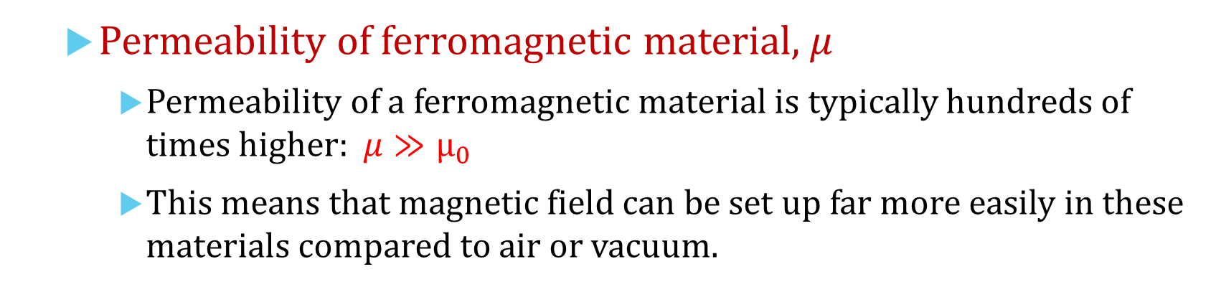
Electromagnetic Properties
Permeability of ferromagnetic material, µ
Permeability of a ferromagnetic material is typically hundreds of times higher: $μ≫μ_{0}$
This means that magnetic field can be set up far more easily in these materials compared to air or vacuum.

Slide 19


Electromagnetic Properties
Relative permeability, µ_{r}
The ratio of permeability of a material to the permeability of vacuum is called relative permeability (µ_{r})
Or
$$μ_{r}=\frac{μ}{μ_{0}}$$
$$μ=μ_{r} μ_{0}$$

Slide 20
Electromagnetic Properties
Relative permeability, µ_{r}
It is more convenient to compare the materials using µ_{r} .
Table displays µ_{r} values of some ferromagnetic materials.
Material | Initial Relative Permeability | Maximum Relative Permeability
Iron, 99.8% pure | 150 | 5,000
Iron, 99.95% pure | 10,000 | 200,000
78 Permalloy | 8,000 | 100,000
Superpermalloy | 100,000 | 1,000,000
Cobalt, 99% pure | 70 | 250
Nickel, 99% pure | 110 | 600
Steel, 0.9% Carbon | 50 | 100
Alnico 5 | 4 | --
Initial relative permeability is the µ_{r} measured in low B values.
The absolute permeability µ of a material is calculated based on its initial permeability value.

Slide 21

Electromagnetic Properties
Reluctance of the flux path, ℛ
Reluctance is the opposition to the establishment of magnetic field in a material.
Analogous to resistance R in an electric circuit.
$ℛ=\frac{l}{μA}$
Value of reluctance ℛ is
directly proportional to length l of the flux path, and
inversely proportional to both permeability μ and cross-sectional area A of material.
Unit of reluctance is ampere-turn/weber (At/Wb).
length (l)
µ
Cross-sectional
area (A)

Slide 22
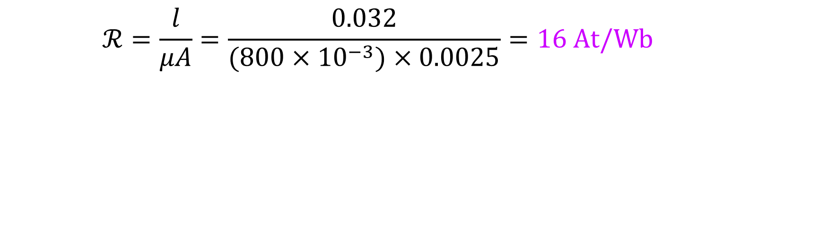
Example 3: What is the reluctance of a material that has a length of 0.032 m, a cross-sectional area of 0.0025 m² and a permeability of 800 mWb/Atm?
$$ℛ=\frac{l}{μA}=\frac{0.032}{(800×{10}^{−3})×0.0025}=16 At/Wb$$

Slide 23
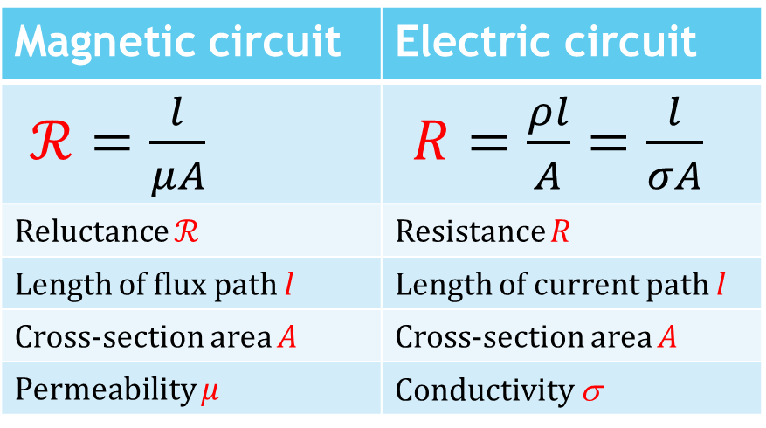
Electromagnetic Properties
Reluctance of the flux path, ℛ
Reluctance in a magnetic circuit is analogous to resistance in an electric circuit.
Magnetic circuit | Electric circuit
$ℛ=\frac{l}{μA}$ | $R=\frac{ρl}{A}=\frac{l}{σA}$
Reluctance ℛ | Resistance R
Length of flux path l | Length of current path l
Cross-section area A | Cross-section area A
Permeability µ | Conductivity σ
Table shows the similarities between parameters of the two circuits.

Slide 24
Electromagnetic Properties
Magnetomotive force (mmf), F_{m}
Current flowing in a conductor produces a magnetic field.
The force that produces the magnetic field is called the magnetomotive force (mmf).
The symbol is F_{m}.

Slide 25
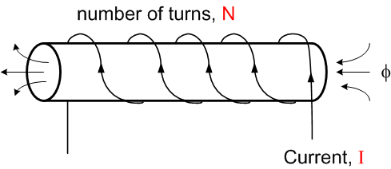

Electromagnetic Properties
Magnetomotive force (mmf), F_{m}
The mmf is the product of current I flowing through a coil and the number of turns N.
Its unit of measurement is ampere-turn (At).
The formula of mmf is:
$$F_{m}=NI$$

Slide 26
You have learned that
Right hand grip rule helps us to remember the directions of current and the magnetic field.
Forces between two long parallel current-carrying conductors can be either repulsive or attractive.
Magnetic properties are similar to electric properties in many aspects.

Slide 27
Coming Up Next
Electromagnets and Magnetic Hysteresis

